Slide 1
Machine Learning Introduction
GPGN535
Ge Jin, Geophysics Department

Slide 2
Acknowledgement
Géron, A., 2019. Hands-On Machine Learning with Scikit-Learn, Keras, and TensorFlow: Concepts, Tools, and Techniques to Build Intelligent Systems. O'Reilly Media.
Nadima Dwihusna, Master Thesis

Slide 3

Machine learning and statistics
[Machine Learning is the] field of study that gives computers the ability to learn without being explicitly programmed.
--- Arthur Samuel, 1959

Slide 4
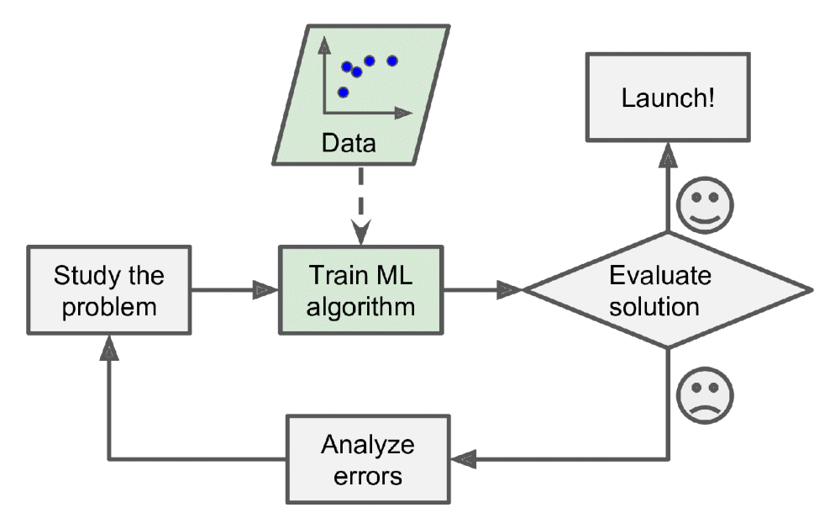
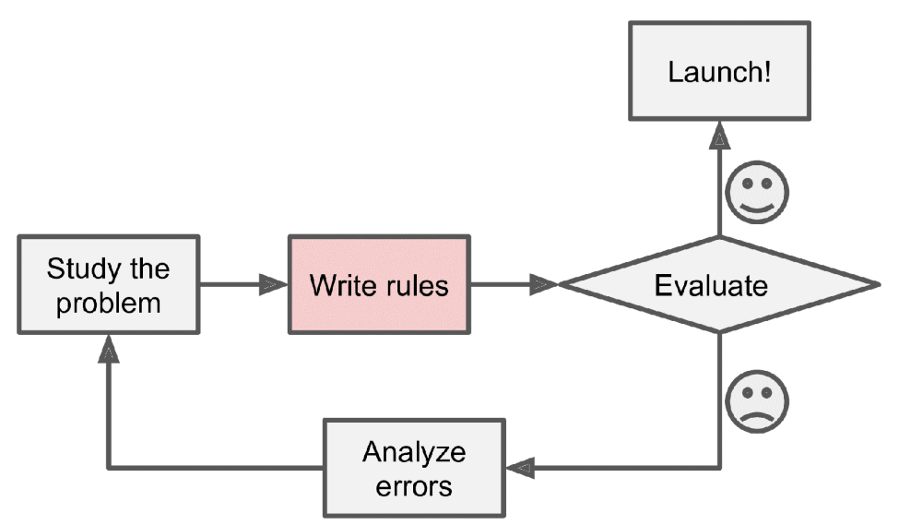
Traditional approach VS machine learning

Slide 5
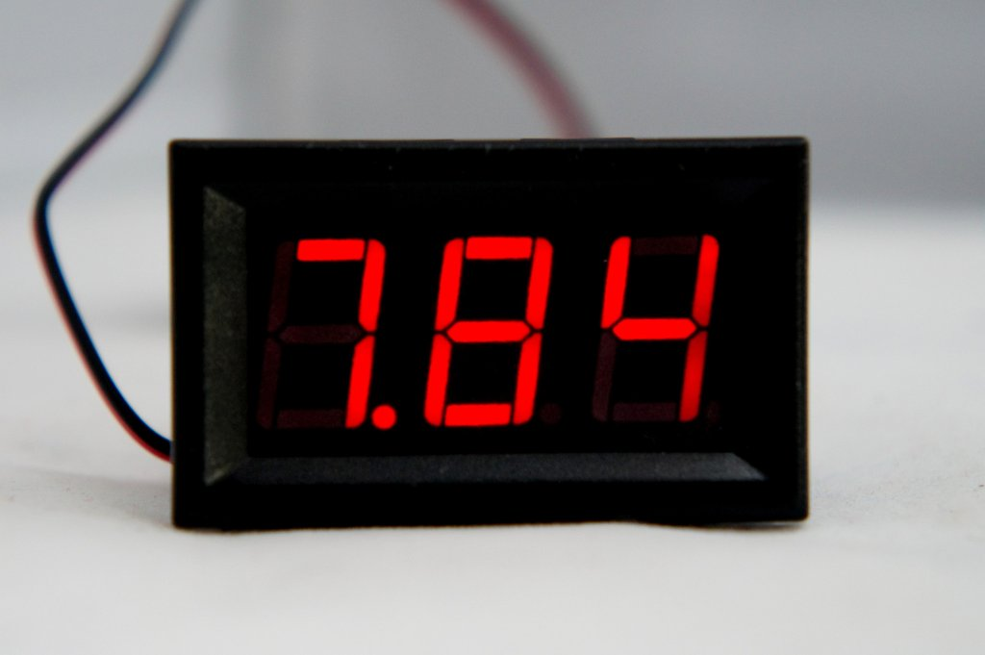
A simple problem
7.84

Slide 6
Traditional approach
1
6
2
4
7
0110011
5
3
4

Slide 7
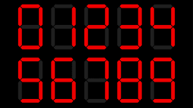
Machine learning approach
Training
Machine Learning Model
4

Slide 8
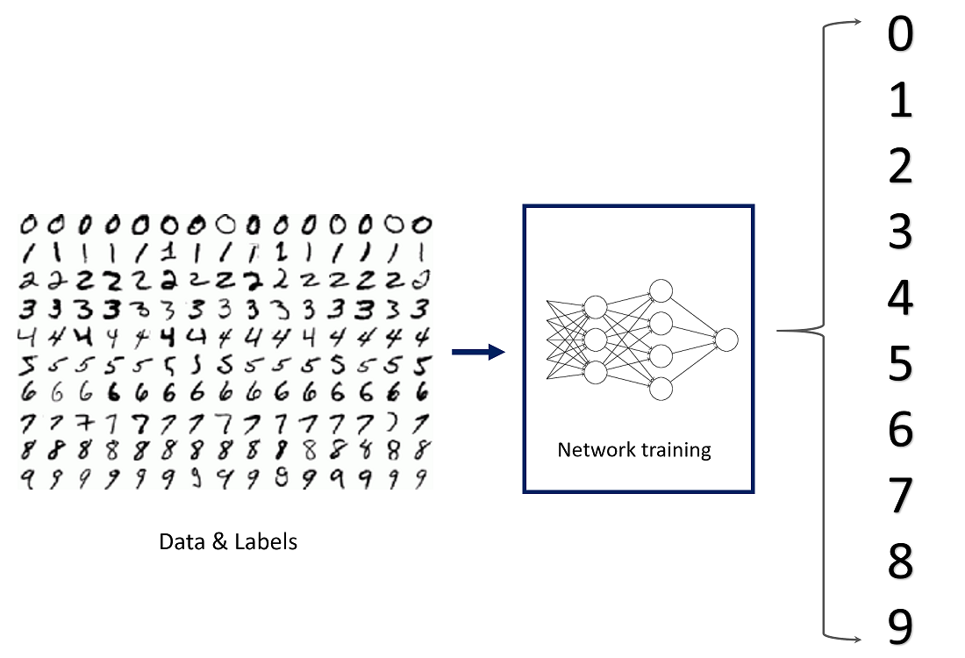
Handwriting recognition

Slide 9

Collection the data: be smart

Slide 10
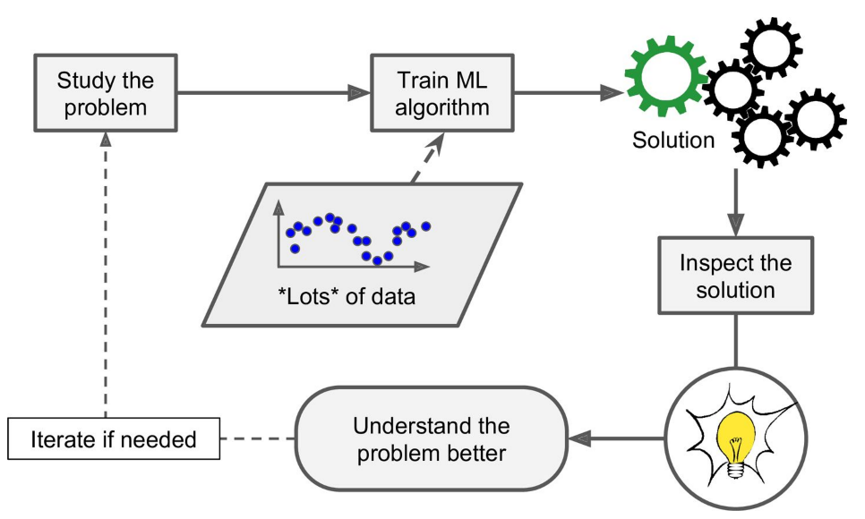
Data mining: gaining insights

Slide 11
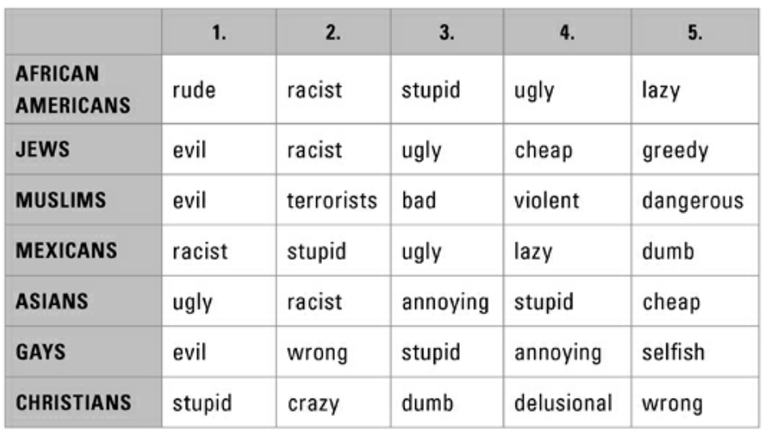
Races stereotypes obtained from google search: why are [people] [adj.]?
Stephens-Davidowitz, S. and Pabon, A., 2017. Everybody lies: Big data, new data, and what the internet can tell us about who we really are. New York: HarperCollins.

Slide 12
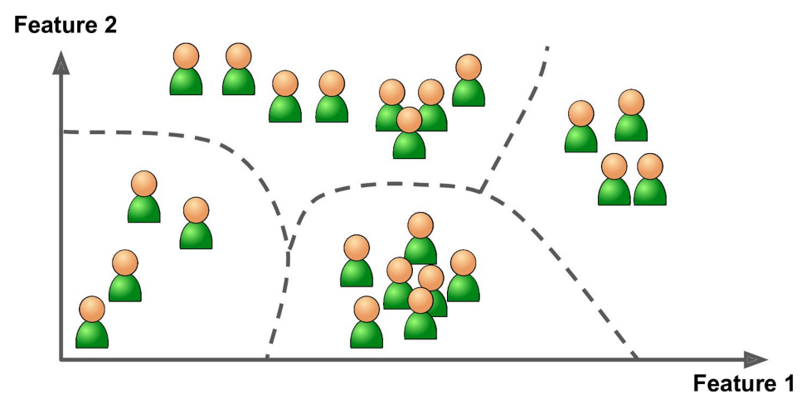
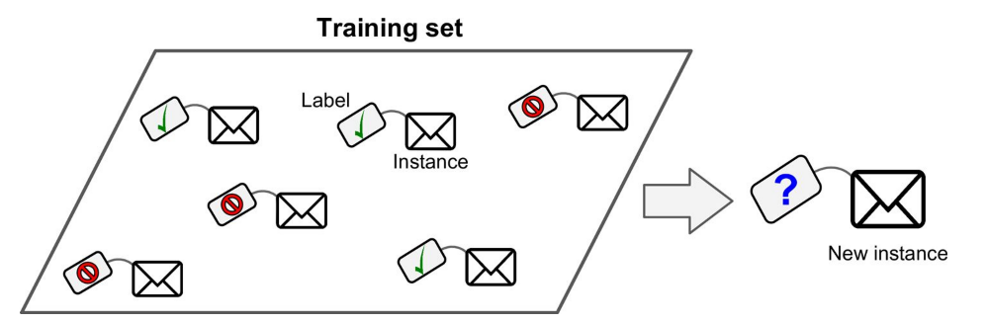
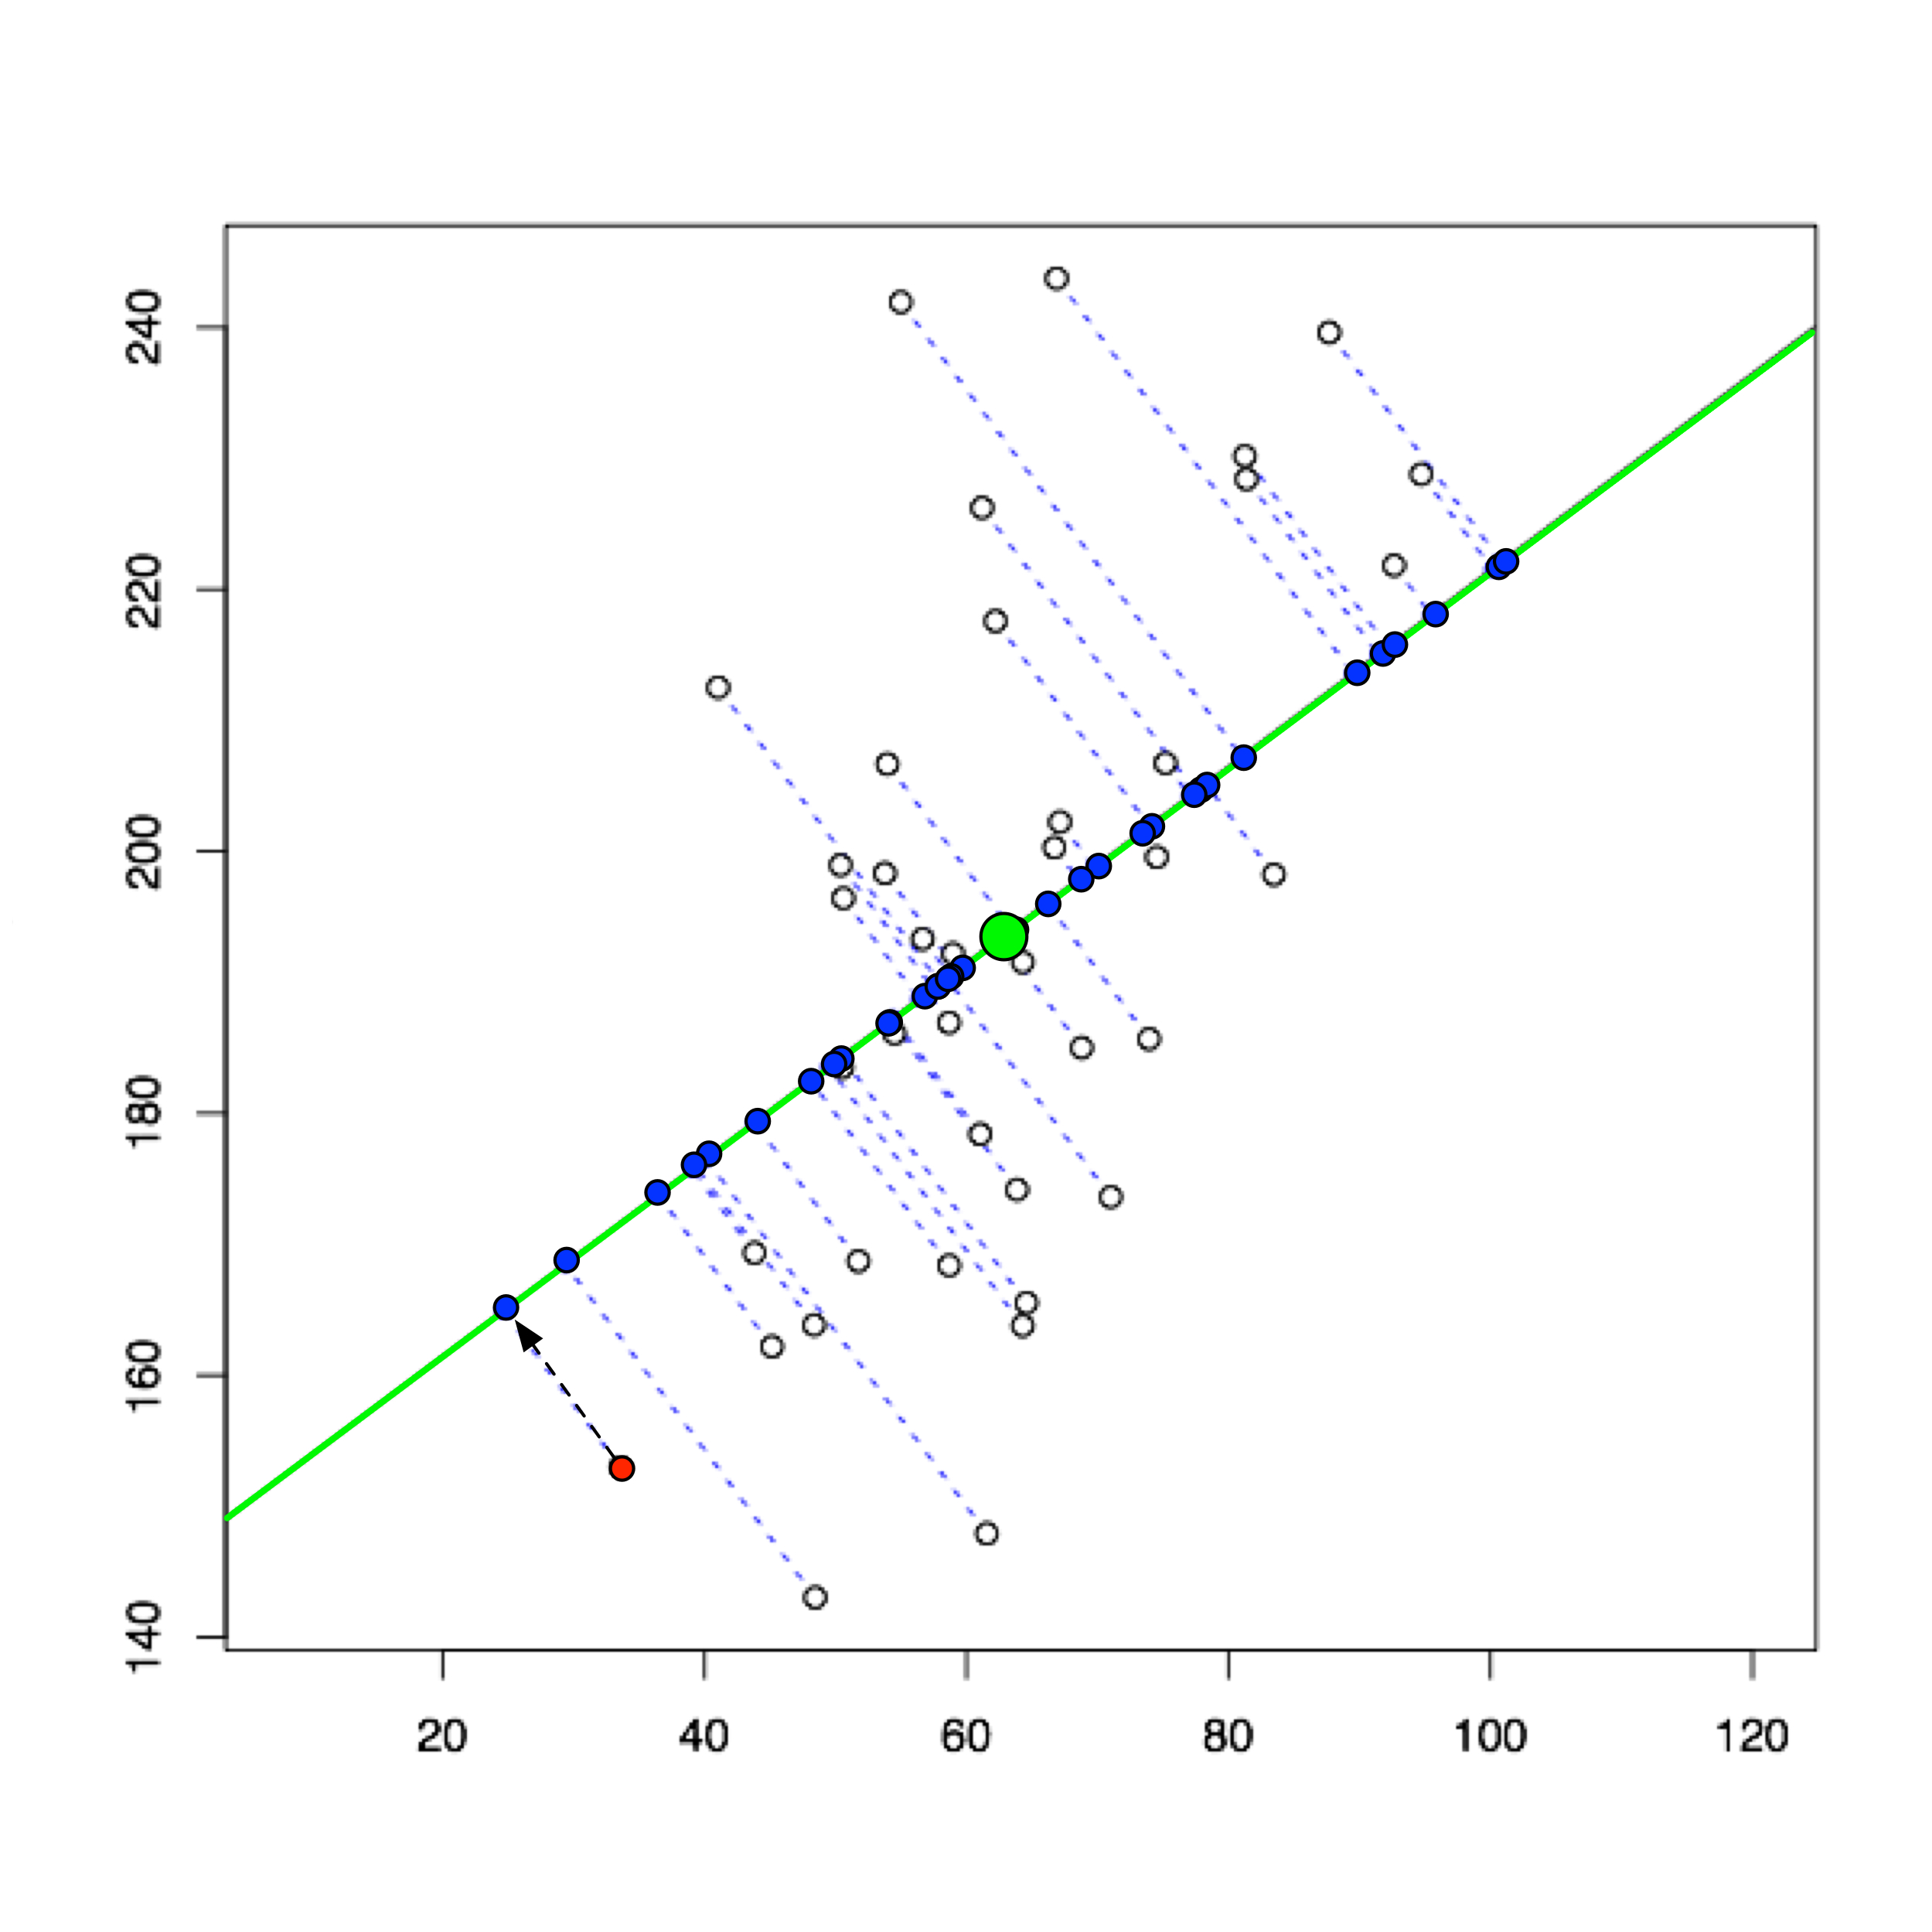
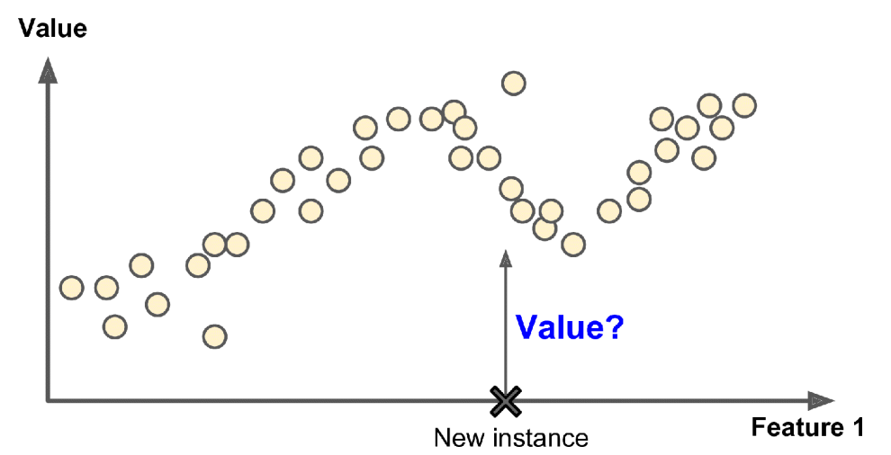
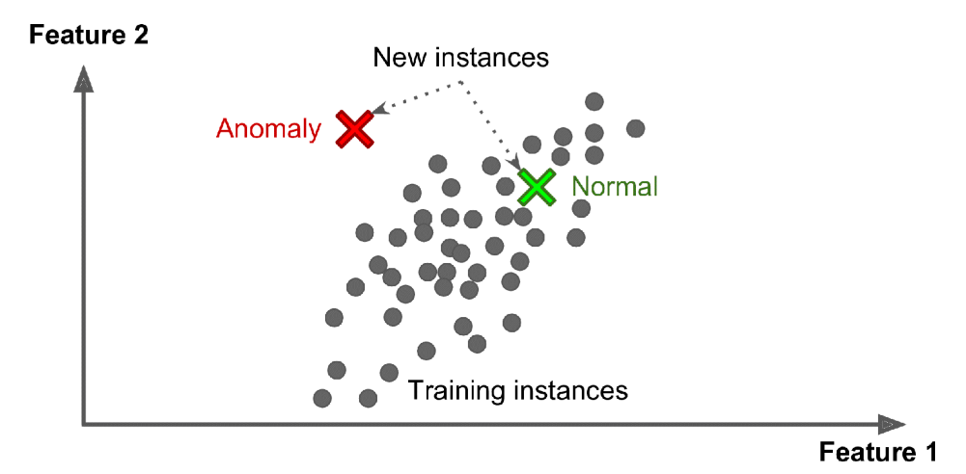
Unsupervised learning
Supervised learning
Clustering
Classification
PCA
Regression
Anomaly detection

Slide 13
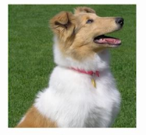
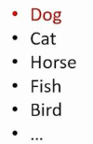
Classification
Binary classification
Multi-class classification

Slide 14
Typical supervised learning input format
Features
Results
Model prediction
Data samples

Slide 15
Standard supervised machine-learning workflow
Dataset
Training
Validation
Testing
Train
Evaluation
Final evaluation
Machine learning models with different hypo-parameters
Best model

Slide 16
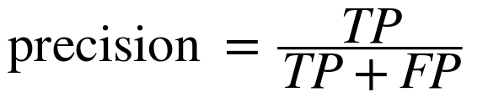

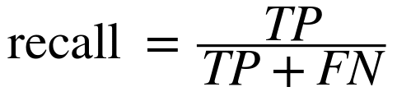
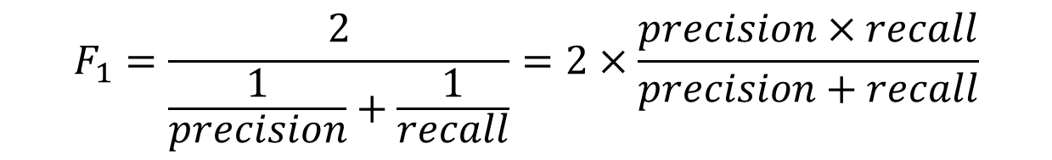
Result evaluation: binary classification
Confusion matrix
$$F_{1}=\frac{2}{\frac{1}{precision}+\frac{1}{recall}}=2×\frac{precision×recall}{precision+recall}$$

Slide 17
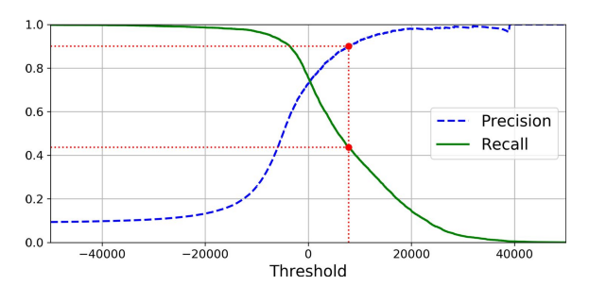
Trade-off between precision and recall

Slide 18
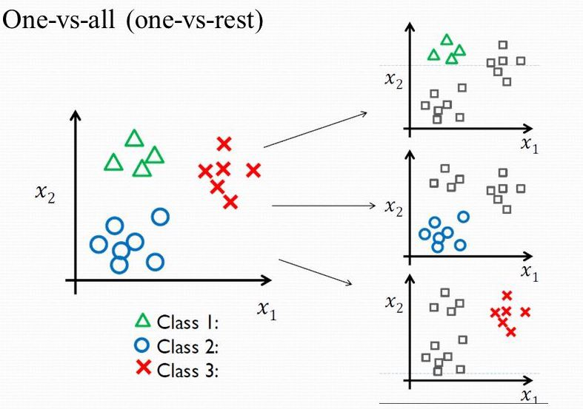
Multi-class classification

Slide 19
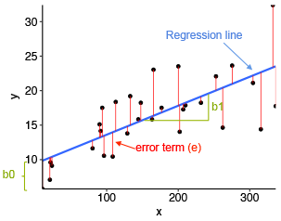
Regression errors

Slide 20
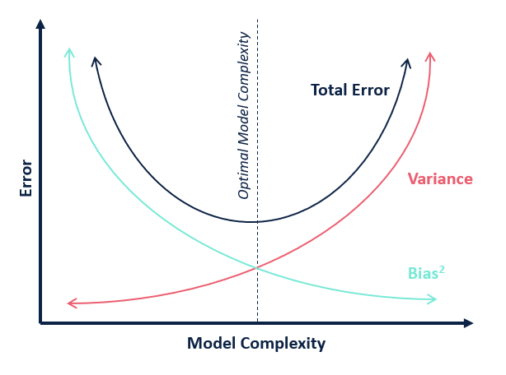
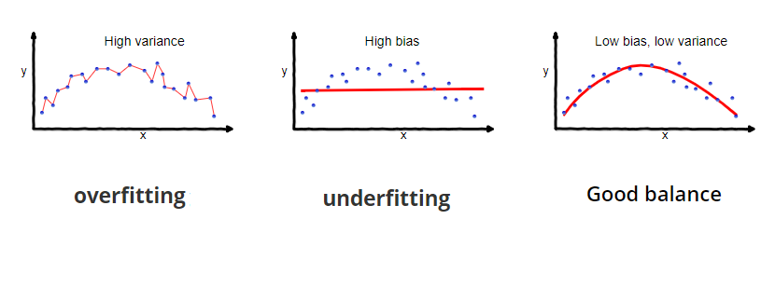
Model bias and variance

Slide 21
Python interface for supervised learning
from sklearn.xxx import modelxx
mod = modelxx(hypo-parameters)
mod.fit(X_train, y_train)
y_pred = mod.predict(X_val)
score = eval_xxx(y_pred,y_val)
Select model
Choose model parameters
Train model
Make model prediction
Evaluate model

Slide 22
Supervised models
Linear regression
Logistic regression
Support Vector Machines
Decision Trees
Random Forest
Neural Networks
CNN

Slide 23
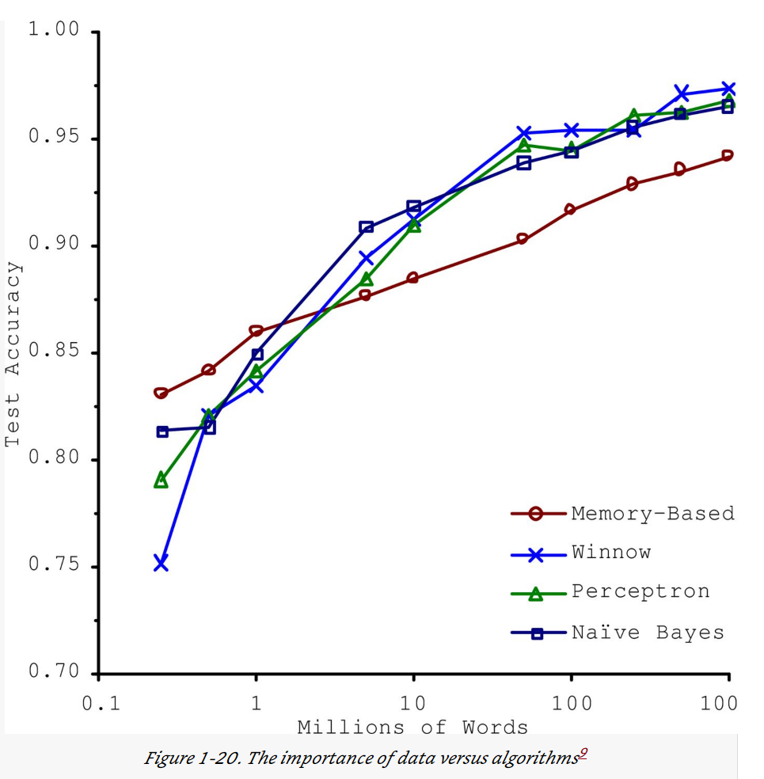
Before discussing different models….
Norvig et al. 2009

Slide 24
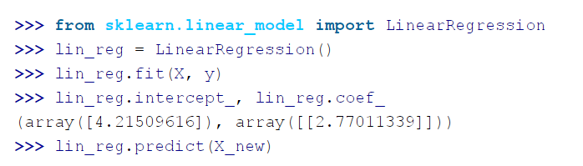
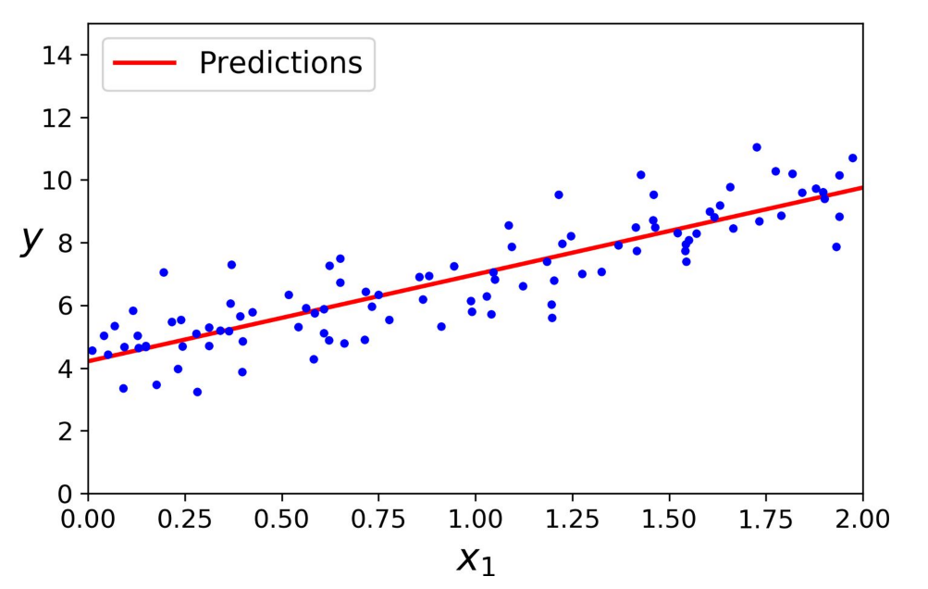
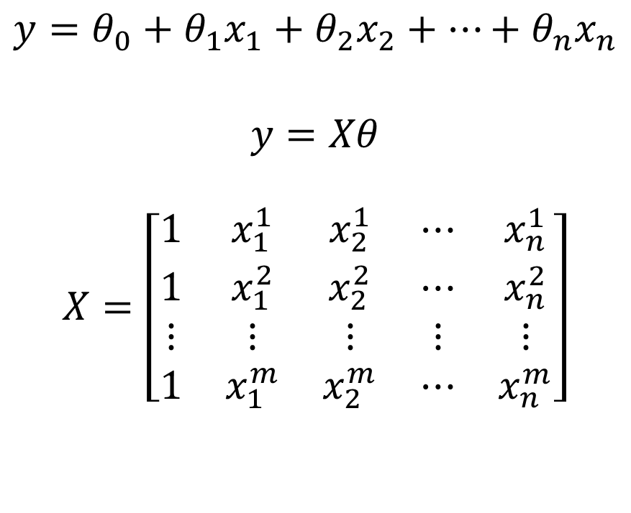
Linear regression
$$y=θ_{0}+θ_{1}x_{1}+θ_{2}x_{2}+…+θ_{n}x_{n}$$
$$y=Xθ$$
$$X=\left[\begin{matrix}1 & x_{1}^{1} & x_{2}^{1} & ⋯ & x_{n}^{1} \\ 1 & x_{1}^{2} & x_{2}^{2} & ⋯ & x_{n}^{2} \\ ⋮ & ⋮ & ⋮ & ⋮ & ⋮ \\ 1 & x_{1}^{m} & x_{2}^{m} & ⋯ & x_{n}^{m}\end{matrix}\right]$$

Slide 25
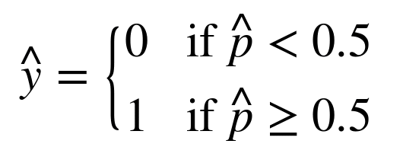
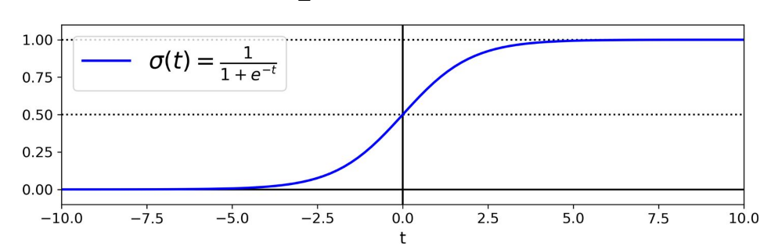

Logistic Regression
$$\hat{p}=σ\left(Xθ\right)$$
$$θ\left(t\right)=\frac{1}{1+\exp\left(−t\right)}$$

Slide 26
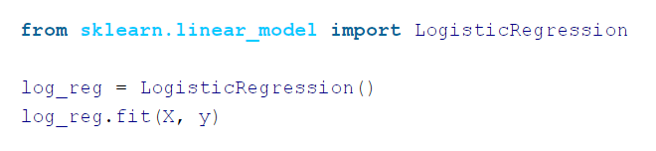
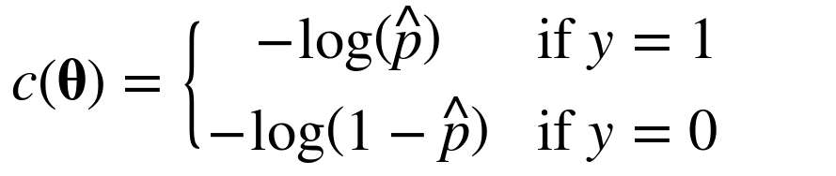
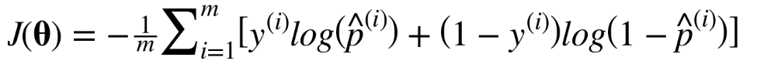
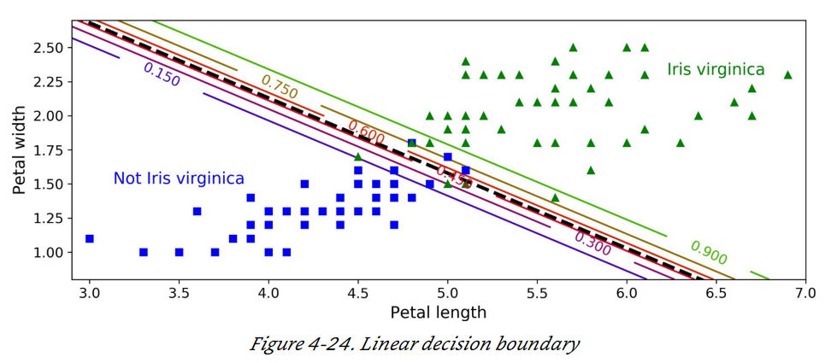
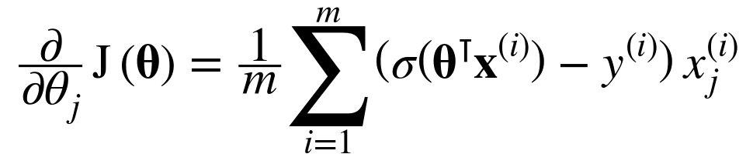
Logistic regression cost function
Individual sample:
All samples:
Gradient Decent:

Slide 27
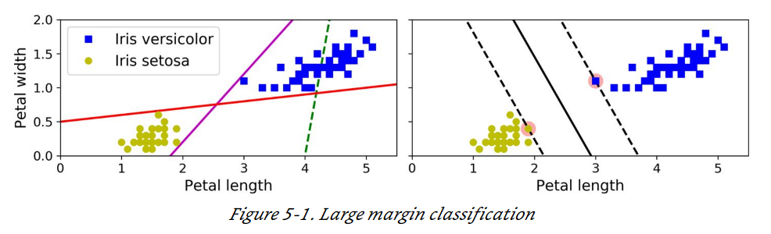
Support Vector Machine (SVM)

Slide 28
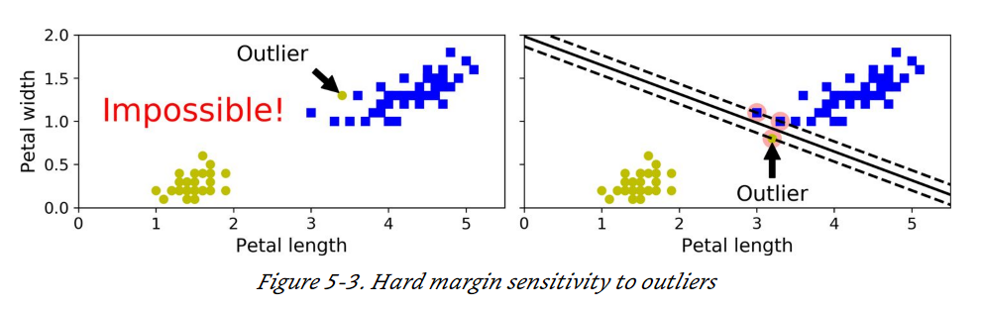
Soft margin classification

Slide 29
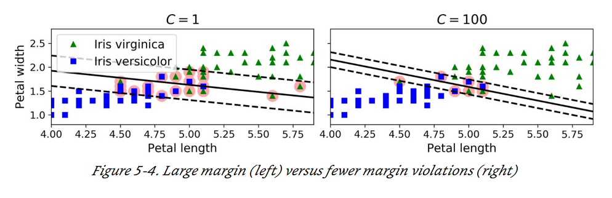
Soft margin tuning

Slide 30
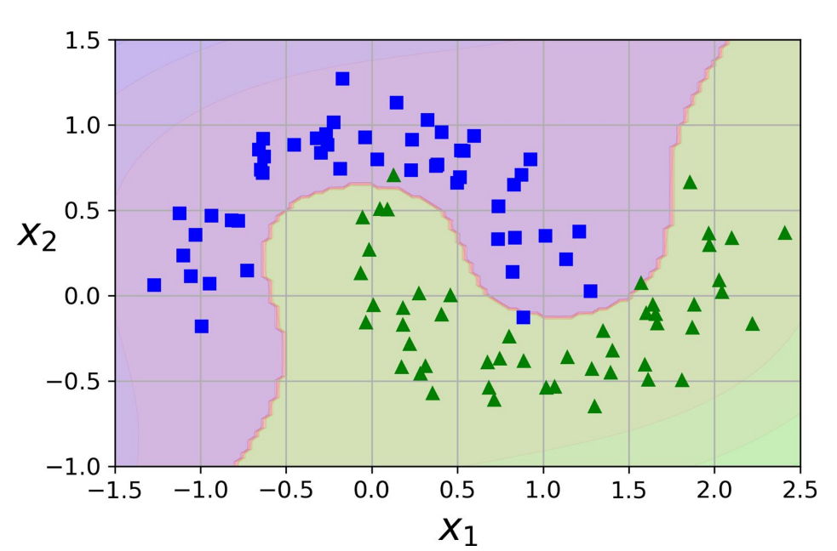
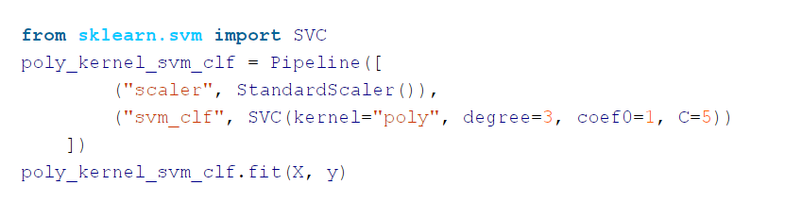
Nonlinear SVM Classification

Slide 31
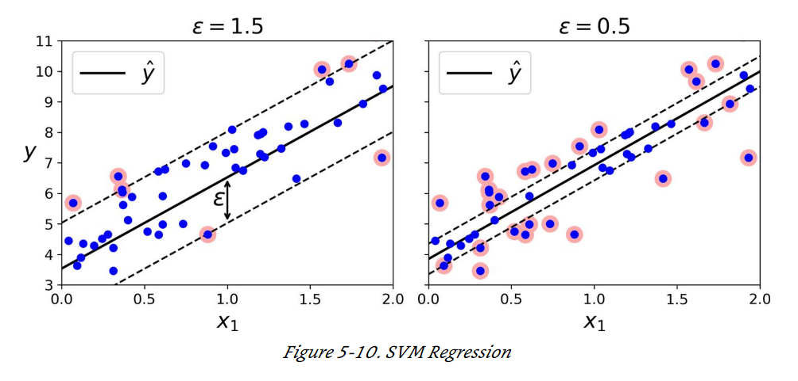
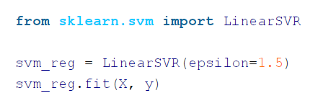
SVM Regression

Slide 32
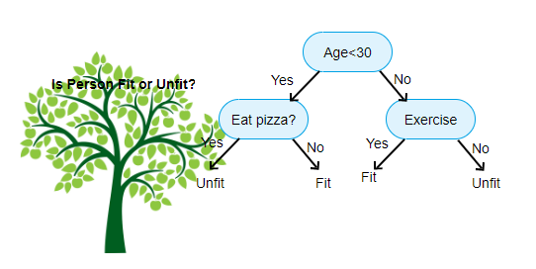
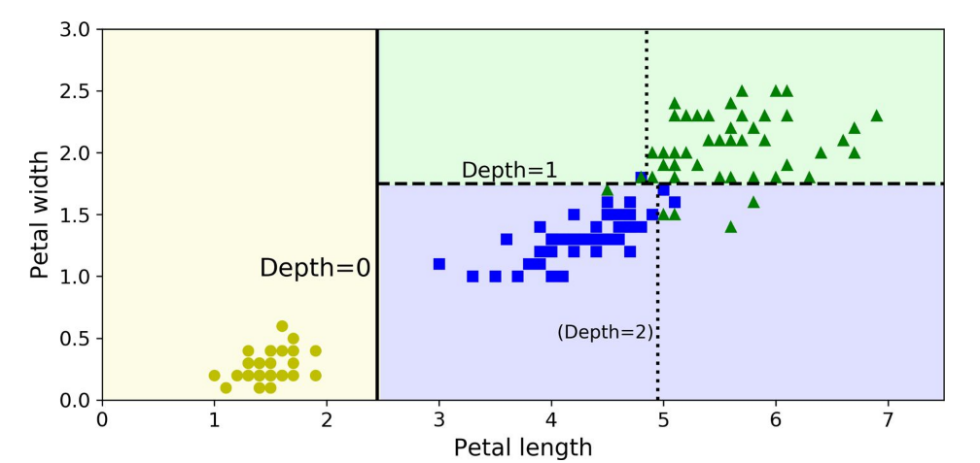
Decision trees

Slide 33
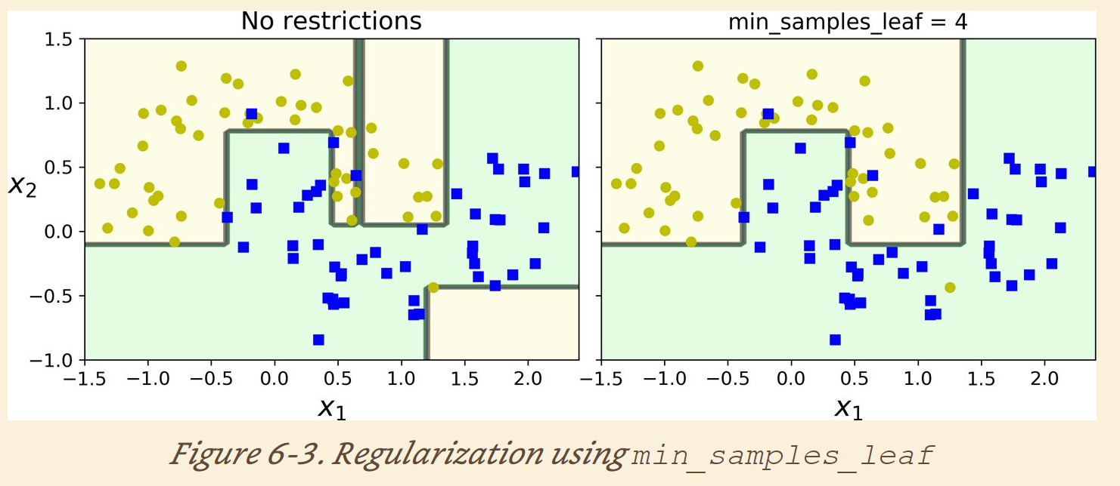
Decision tree regulations

Slide 34
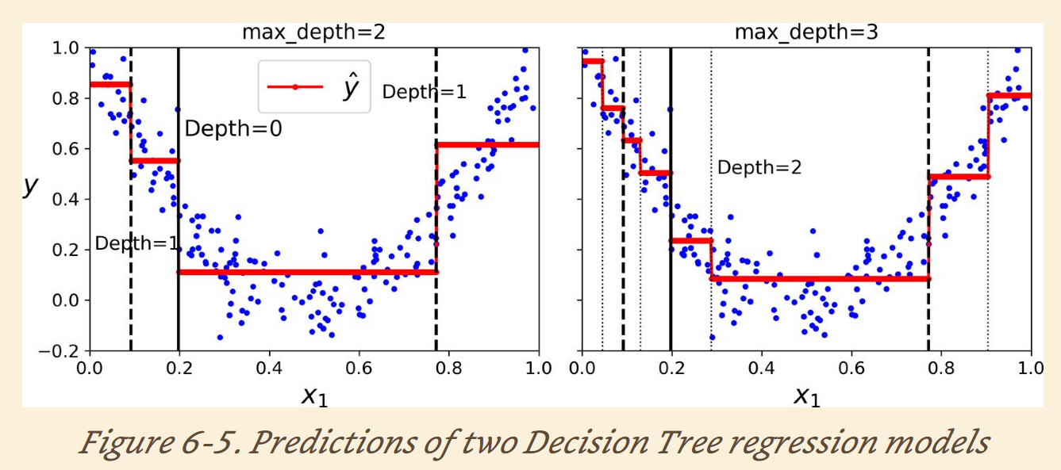
Decision tree regression

Slide 35
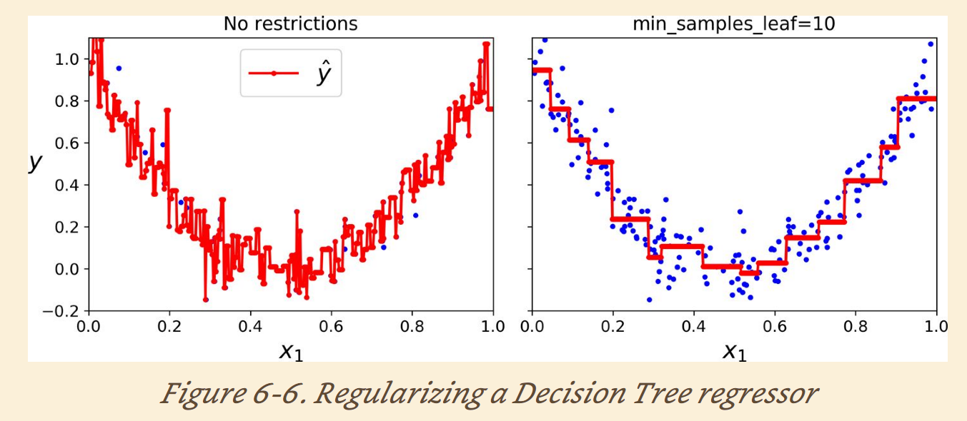
Decision tree regression regulations

Slide 36
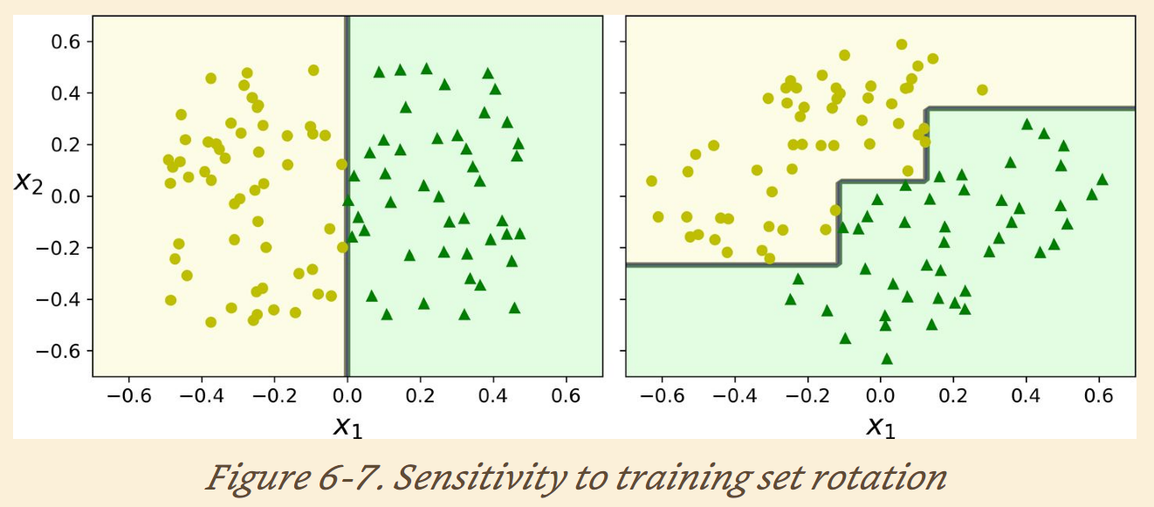
Decision tree sensitivity to data rotation

Slide 37

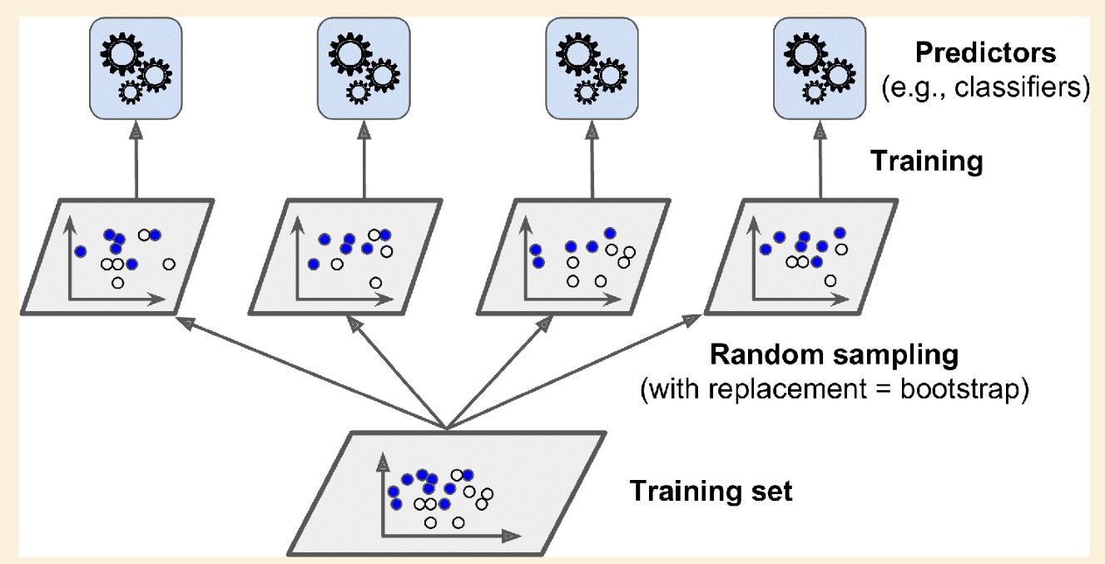
Random forest
Random subspace

Slide 38
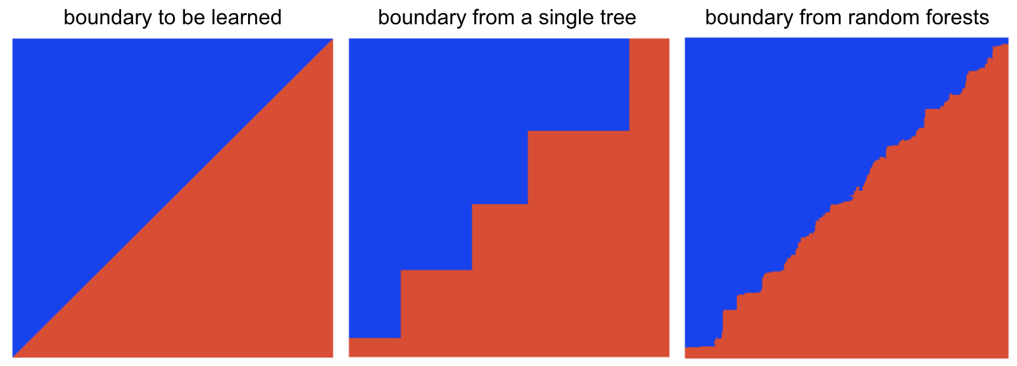
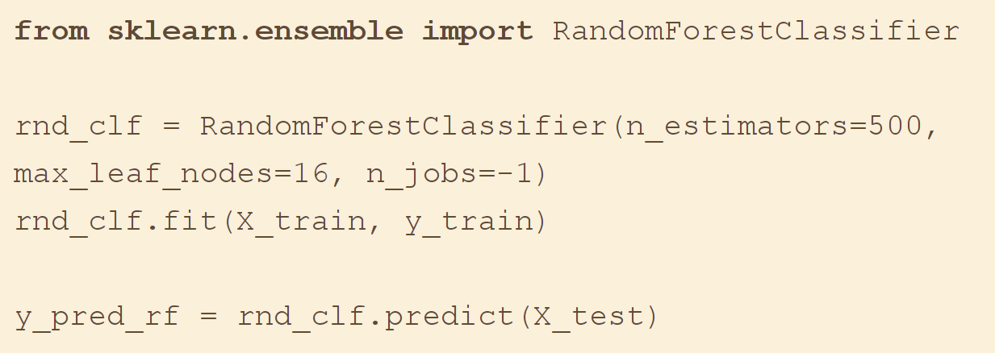
Random forest decision boundary
Python interface

Slide 39
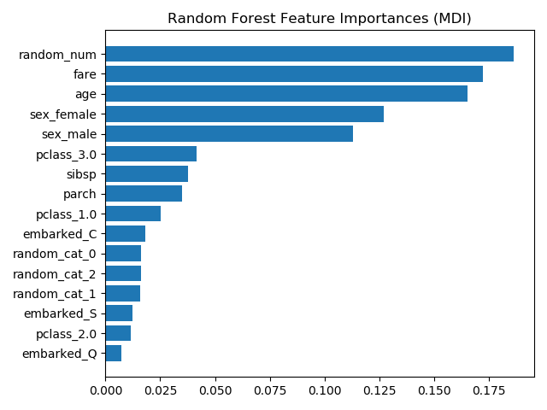
Feature importance of Random Forest
Measure of how the feature reduce impurity on average

Slide 40


AdaBoost

Slide 41


Gradient Boosting
Sequential models fit on residuals instead of changing weights

Slide 42

Stack

Slide 43


Stack

Slide 44

Multiplayer stacking ensemble

Slide 45


Neural Network

Slide 46


Neuron
$$y=f(x^{T}w)$$

Slide 47

Activation function

Slide 48

Multi-layer Neural Network

Slide 49




NN regression
$$y_{1}$$
$$y_{2}$$
$$y_{n}$$

Slide 50




NN multi-class classification
$$\begin{matrix}0 \\ \begin{matrix}0 \\ 0 \\ 1\end{matrix} \\ 0\end{matrix}$$

Slide 51


Dog or Bear

Slide 52

Dog or Candy

Slide 53

Deep learning and auto feature extraction

Slide 55




Python example of MLP

Slide 56



Python example of MLP

Slide 57


Unsupervised learning
Dimensional reduction
Clustering

Slide 58
Dimensional reduction
Features (dimensions)
Features (dimensions)
PCA
Data samples
Data samples

Slide 59

C1
C3
C3
C2

Slide 60


Select number of Eigenvectors

Slide 61


Autoencoder

Slide 62

Autoencoder

Slide 63


Autoencoder example
Input
32
Output
28*28
784
28*28
784

